Slide 1
WELCOME

Slide 2
Introduction with teacher
Md: Aftab uddin
Assistant teacher
Gobra pancha polly secondary school
Shalikha, Magura
Id No-882

Slide 3
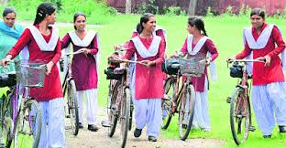
Look at the picture
They are going to school

Slide 4
They = Subject
Are = Auxiliary verb
go = Principal verb
to = Preposition

Slide 5
Todays lessons
Preposition
Class-6
Subject: English 2nd paper
Unit,3 Lesson-1
Time:30 Minutes
Date:17/05/2019
Total ss-

Slide 6
We will be able to tell
At the end of the lesson
practiced writing and speaking skill
What is preposition?
Learn the classification of it
Use appropriate of preposition
*

Slide 7
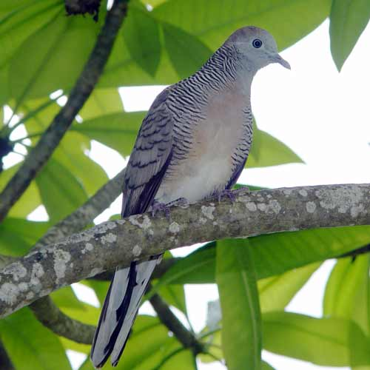
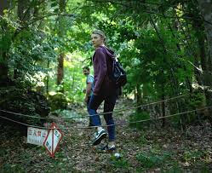
The bird is on the tree.
The man is into the forest.

Slide 8
So, What is the preposition?
Pre means before, and position means place
Pre means that which is placed before,
Before Noun or Pronoun
So, preposition is a word that is placed before a noun or pronoun to show its relation with other words in the sentence.

Slide 9
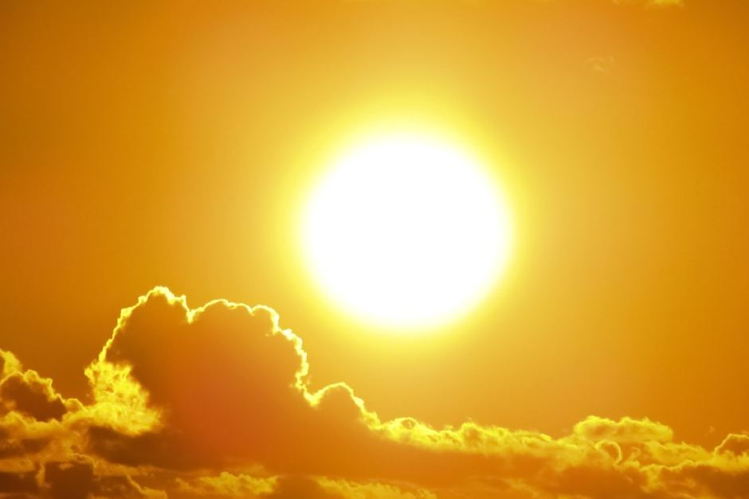
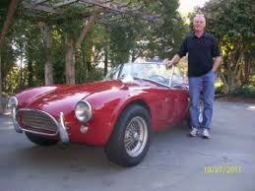
The sun above the trees
A one man beside the car

Slide 10
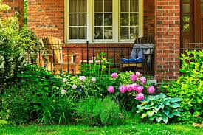
There is a garden in front of the house
The man and woman between the fight

Slide 11
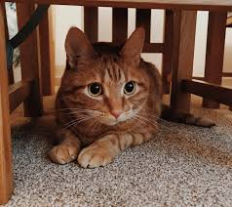
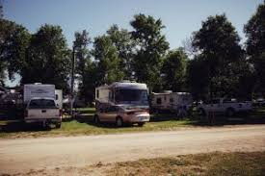
The cat is sitting under the table.
There are many trees behind the car

Slide 12
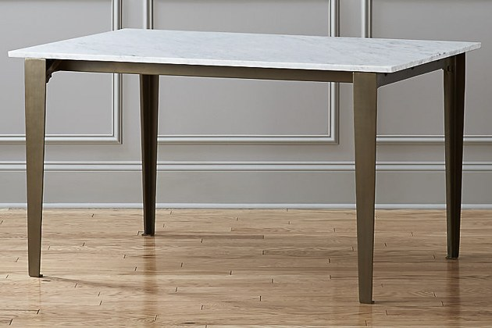
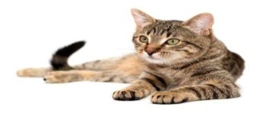
Evaluation
Write five sentences using the following prepositions

Slide 13
Home work:
In, into, on, beside, above,

Slide 14
Many thanks

